Slide 1

UNIVERSITY INSTITUTE OF ENGINEERING CHANDIGARH UNIVERSITY Bachelor of Engineering Subject Name: Discrete Structure Subject Code: CST-352 Binary Relations, Types of Relations

Slide 2

Course Outcome
CO2
Understand the concepts and perform the operations related to sets, relations and functions

Slide 3
Binary Relation
A binary relation R from set A to set B is a subset of the Cartesian product A×B.
R⊆A×B
As in Cartesian product of two sets A and B, is the set of all possible ordered pairs (a, b), where a ∈ A and b ∈ B:
A×B={(a,b)∣a∈A and b∈B}

Slide 4
Binary Relation
A binary relation describes a relationship between the elements of two sets.
If A and B are sets, then a binary relation R from A to B is a subset of the Cartesian product of A and B (A x B).
Let A = {1, 2, 3} and B = {4, 5, 6}. Let R be a binary relation from A to B as follows:
given any (x, y) € A x B, (x, y) € R ↔ y/x € Z

Slide 5
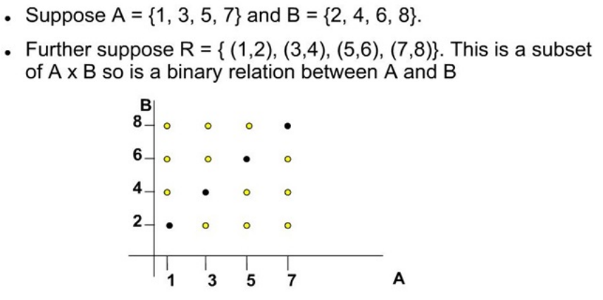
Binary Relation
Example

Slide 6
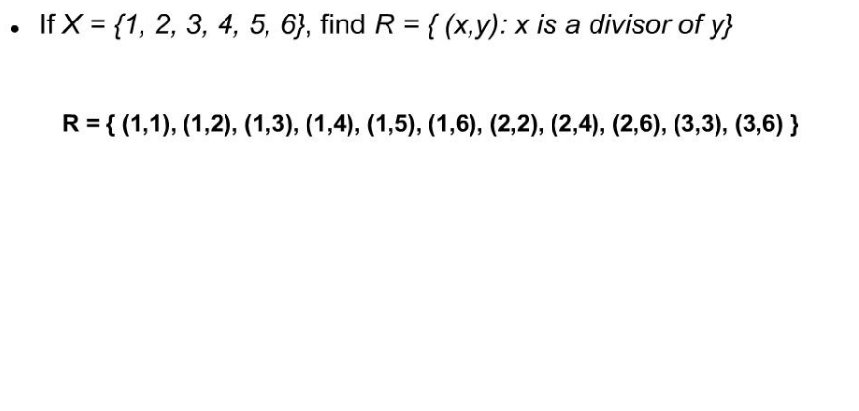
Binary Relation
Example

Slide 7
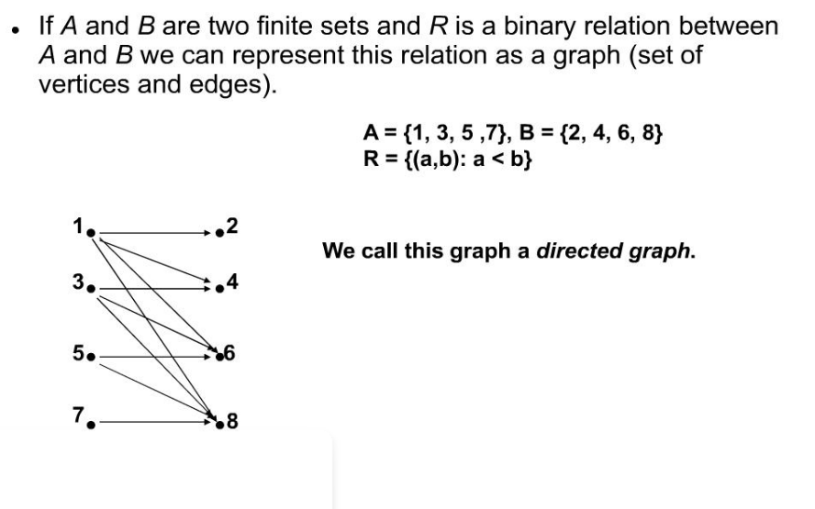
Graph Representation of a Binary Relation

Slide 8
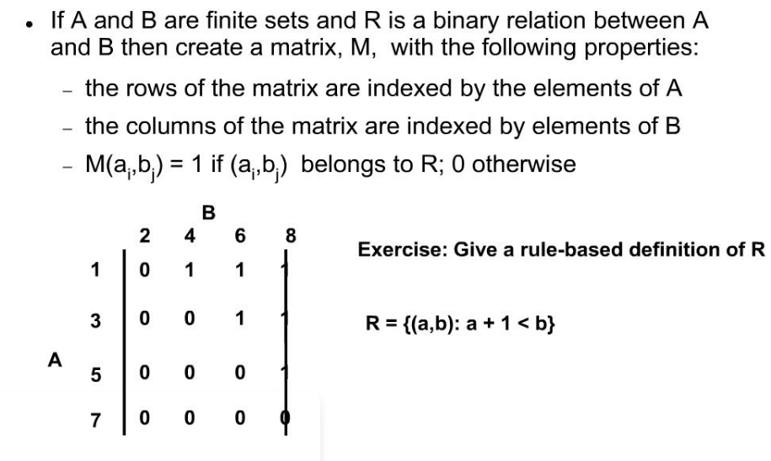
Matrix Representation of Binary Relation

Slide 9
Relation
A connection between the elements of two or more sets is Relation. The sets must be non-empty.
A subset of the Cartesian product also forms a relation R.
A relation may be represented either by Roster method or by Set-builder method.
Let A and B be two sets such that A = {2, 5, 7, 8, 10, 13} and B = {1, 2, 3, 4, 5}.
R = {(x, y): x = 4y – 3, x ∈ A and y ∈ B} (Set-builder form)

Slide 10
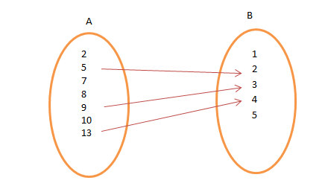
Relation
R = {(5, 2), (10, 3), (13, 4)} (Roster form)

Slide 11
Types of Relations
Empty Relation
Universal Relation
Identity Relation
Inverse Relation
Reflexive Relation
Symmetric Relation
Transitive Relation
Equivalence Relation

Slide 12
Empty Relation
If no element of set X is related or mapped to any element of X, then the relation R in A is an empty relation, i.e, R = Φ.
Consider an example of set A consisting of only 100 hens in a poultry farm.
Is there any possibility of finding a relation R of getting any elephant in the farm?
No! R is a void or empty relation since there are only 100 hens and no elephant.

Slide 13
Universal Relation
A relation R in a set, say A is a universal relation if each element of A is related to every element of A, i.e., R = A × A.
It is also called Full relation.
Suppose A is a set of all natural numbers and B is a set of all whole numbers.
The relation between A and B is universal as every element of A is in set B.
Empty relation and Universal relation are sometimes called trivial relation.

Slide 14
Identity Relation
In Identity relation, every element of set A is related to itself only.
I = {(a, a), ∈ A}
For example,
If we throw two dice, we get 36 possible outcomes, (1, 1), (1, 2), … , (6, 6).
A relation is defined as R: {(1, 1), (2, 2), (3, 3), (4, 4), (5, 5), (6, 6)}, it is an identity relation.

Slide 15
Inverse Relation
Let R be a relation from set A to set B i.e., R ∈ A × B.
The relation R⁻¹ is said to be an Inverse relation if R⁻¹ from set B to A is denoted by R⁻¹ = {(b, a): (a, b) ∈ R}.
Considering the case of throwing of two dice if R = {(1, 2), (2, 3)},
R⁻¹ = {(2, 1), (3, 2)}.
Here, the domain of R is the range of R⁻¹ and vice-versa.

Slide 16
Reflexive Relation
If every element of set A maps to itself, the relation is Reflexive Relation.
For every a ∈ A, (a, a) ∈ R.
A relation R is A relation R is reflexive iff, for any x ∈ S, x R x.
Example:
let R be defined as follows:
for all x, y ∈ S, x R y ↔ xy > 0 reflexive iff, for any x ∈ S, x R x.

Slide 17
Reflexive Relation
Then R is reflexive, since:
-1 R -1 | -1 * -1 > 0
1 R 1 | 1 * 1 > 0
2 R 2 | 2 * 2 > 0

Slide 18
Symmetric Relation
A relation R on a set A is said to be symmetric if (a, b) ∈ R then (b, a) ∈ R, for all a & b ∈ A.
A relation R is symmetric iff, for all x, y ∈ S, if x R y then y R x.

Slide 19
Symmetric Relation
Let R be defined as follows: for all x, y ∈ S, x R y ↔ x² + y > 0
R is symmetric as follows:
Note that this relationship is also by definition reflexive: if x R x. then x R x.
-12+ 1 > 0 | 12+ -1 > 0
-12+ 2 > 0 | 22+ -1 > 0
12+ 2 > 0 | 22+ 1 > 0

Slide 20
Transitive Relation
A relation in a set A is transitive if, (a, b) ∈ R, (b, c) ∈ R, then (a, c) ∈ R, for all a, b, c ∈ A
A relation R is transitive iff, for all x, y S, if x R y and y R z then x R z.

Slide 21
Transitive Relation
Let R be defined as follows:
for all x, y, z ∈ S, x R y ↔ x²+1 > y
R is transitive as follows:
for x = -1, y = 1, and z = 2;
This relationship holds for any other combination of x, y, z ∈ S.
-12+ 1 > 1 | x2+1 > y
12+ 1 > 2 | y2+1 > z
-12+ 1 > 2 | x2+1 > z

Slide 22
Equivalence Relation and Partitions
A relation is said to be equivalence if and only if it is Reflexive, Symmetric, and Transitive.
For example, if two dices are thrown, say A & B and note down all the possible outcome.
Define a relation R= {(a, b): a ∈ A, b ∈ B}, find that {(1, 1), (2, 2), …, (6, 6) ∈ R} (reflexive).
If {(a, b) = (1, 2) ∈ R} then, {(b, a) = (2, 1) ∈ R} (symmetry). ).
If {(a, b) = (1, 2) ∈ R} and {(b, c) = (2, 3) ∈ R} then {(a, c) = (1, 3) ∈ R} (transitive)

Slide 23
Properties of Equivalence Classes
If R (also denoted by ∼) is an equivalence relation on set A, then
Every element a∈A is a member of the equivalence class [a].
∀a∈A,a∈[a]
Two elements a,b∈A are equivalent if and only if they belong to the same equivalence class.
∀a,b∈A,a∼b iff [a]=[b]
Every two equivalence classes [a] and [b] are either equal or disjoint.
∀a,b∈A,[a]=[b] or [a]∩[b]=∅

Slide 24
Example
Consider three right angle triangles T₁ with sides 3,4,5, T₂ with sides 5,12,13 and T₃ with sides 6,8,10. Which triangles among T₁, T₂ and T₃ are related?
R = {(T₁, T₂): T₁ is similar to T₂}
T₁ has sides 3, 4, 5, T₂ has sides 5,12,13 and T₃ has sides 6,8,10
Two triangles are similar if ratio of their sides are equal
For triangle T₁ & T₃
Ratio of sides 3/6=4/8=5/10=1/2. Since, ratio of sides is equal,
T₁ & T₃ are similar, i.e. T₁ & T₃ are related.

Slide 25
Partitions
Let A be a set and A1,A2,…,An be its non-empty subsets. The subsets form a partition P of A if
The union of the subsets in P is equal to A.
⋃i=1nAi=A1∪A2∪…∪An=A
The partition P does not contain the empty set ∅.
Ai≠∅∀i
The intersection of any distinct subsets in P is empty.
Ai∩Aj=∅∀i≠j

Slide 26
Partitions
There is a direct link between equivalence classes and partitions.
For any equivalence relation on a set A, the set of all its equivalence classes is a partition of A.
The converse is also true.
Given a partition P on set A, we can define an equivalence relation induced by the partition such that a∼b if and only if the elements a and b are in the same block in P.

Slide 27
Partial Order Relations
A binary relation R on a set S is called a partial ordering, or partial order if and only if it is Reflexive, Antisymmetric and Transitive.
Partial order allow elements to “preceed” one another but not necessarily.
Examples:
subsets of a set are ordered partially

Slide 28
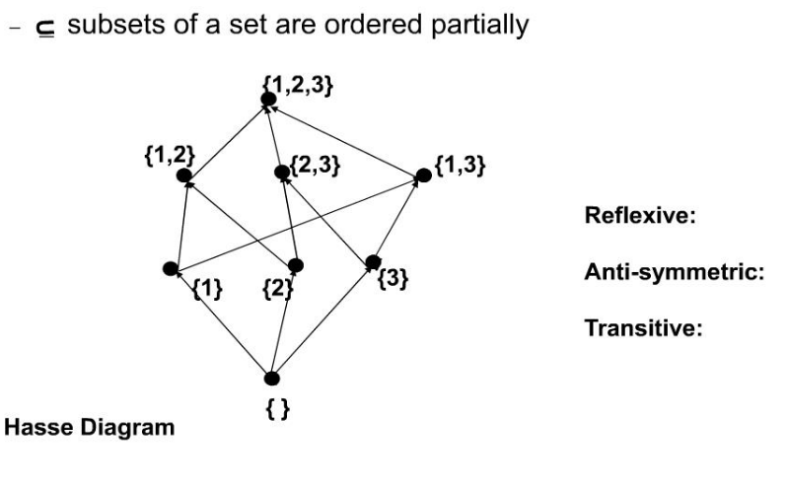
Partial Orders

Slide 29
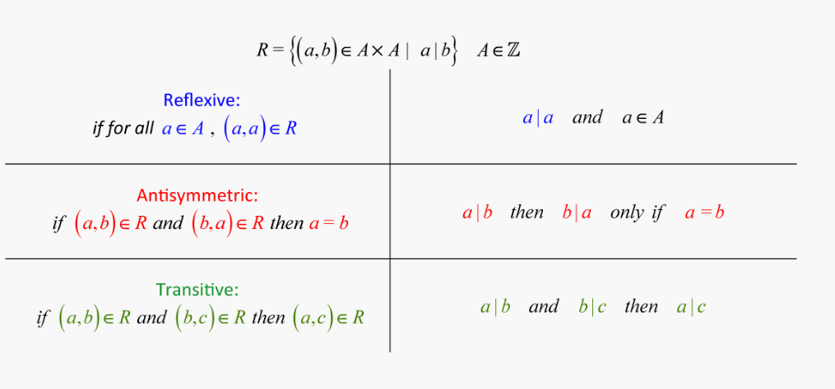
Partial Orders

Slide 30
Functions and its Type
A Function assigns to each element of a set, exactly one element of a related set.
A function or mapping (Defined as f:X→Y) is a relationship from elements of one set X to elements of another set Y (X and Y are non-empty sets).
X is called Domain and Y is called Codomain of function ‘f’.
Function ‘f’ is a relation on X and Y such that for each x∈X, there exists a unique y∈Y such that (x,y)∈R. ‘x’ is called pre-image and ‘y’ is called image of function f.
A function can be one to one or many to one but not one to many.

Slide 31
Types of Functions
These are some of the types of function:
Injective/ One-to-one Function
Surjective/ Onto Function
Bijective/One-to-one Correspondent
Many-One Function

Slide 32
Injective/One-to-one Function:
A function f:A→B is injective or one-to-one function if for every b∈B, there exists at most one a∈A such that f(s)=t.
This means a function f is injective if a1≠a2a1≠a2 implies f(a1)≠f(a2)f(a1)≠f(a2).
Example:
f:N→N,f(x)=5xf:N→N,f(x)=5x is injective.
f:N→N,f(x)=x2f:N→N,f(x)=x2 is injective.
f:R→R,f(x)=x2f:R→R,f(x)=x2 is not injective as (−x)2=x2(−x)2=x2

Slide 33
Surjective/Onto Function
A function f:A→B is surjective (onto) if the image of f equals its range. Equivalently, for every b∈B, there exists some a∈A such that f(a)=b.
This means that for any y in B, there exists some x in A such that y=f(x).
Example:
f:N→N,f(x)=x+2 is surjective.
f:R→R,f(x)=x2 is not surjective since we cannot find a real number whose square is negative.

Slide 34
Bijective/One-to-one Correspondent
A function f:A→B is bijective or one-to-one correspondent if and only if f is both injective and surjective.
Prove that a function f:R→R defined by f(x)=2x–3 is a bijective function.
To prove this function is both injective and surjective.
If f(x1)=f(x2), then 2x1–3=2x2–3 and it implies that x1=x2.
Hence, f is injective.
Here, 2x–3=y
So, x=(y+5)/3 which belongs to R and f(x)=y.
Hence, f is surjective. Since f is both surjective and injective, therefore f is bijective.

Slide 35
Many-One Function
Let f: X → Y. The function f is said to be many-one functions if there exist two or more than two different elements in X having the same image in Y.
Example:
Consider X = {1, 2, 3, 4, 5}
Y = {x, y, z} and f: X → Y such that
f = {(1, x), (2, x), (3, x), (4, y), (5, z)}
The function f is many-one function.

Slide 36
Composite Functions and Relation
Let f : A → B and g : B → C be two functions.
Then the composition of f and g, denoted by g ∘ f, is defined as the function g ∘ f : A → C given by g ∘ f (x) = g(f (x)), ∀ x ∈ A.
The order of function is an important thing while dealing with the composition of functions since (f ∘ g) (x) is not equal to (g ∘ f) (x).
Example
If f(x) = 3x+1 and g(x) = x2 , then f of g of x, f(g(x)) = f(x2) = 3x2+1.
If we reverse the function operation, such as f of f of x,
g(f(x)) = g(3x+1) = (3x+1)2

Slide 37
Properties of Function Compositions
Associative Property: As per the associative property of function composition, if there are three functions f, g and h, then they are said to be associative if and only if;
f ∘ (g ∘ h) = (f ∘ g) ∘ h
Commutative Property: Two functions f and g are said to be commute with each other, if and only if;
g ∘ f = f ∘ g

Slide 38
Properties of Function Compositions
Few more properties are:
The function composition of one-to-one function is always one to one.
The function composition of two onto function is always onto
The inverse of the composition of two functions f and g is equal to the composition of the inverse of both the functions, such as (f ∘ g)-1 = ( g-1 ∘ f-1).

Slide 39
Facts about Composition
If f and g are one-to-one then the function (gof) is also one-to-one.
If f and g are onto then the function (gof) is also onto.
Composition always holds associative property but does not hold commutative property.

Slide 40
Applications
Functions find their application in various fields like:
representation of the computational complexity of algorithms, counting objects,
study of sequences and
strings, to name a few

Slide 41
Inverse of Relations and Functions
An inverse relation is the inverse of a relation and is obtained by interchanging the elements of each ordered pair of the given relation. Let R be a relation from a set A to another set B. Then R is of the form {(x, y): x ∈ A and y ∈ B}. The inverse relationship of R is denoted by R⁻¹ and its formula is R⁻¹ = {(y, x): y ∈ B and x ∈ A}. i.e.,
The first element of each ordered pair of R = second element of corresponding ordered pair of R⁻¹.
The second element of each ordered pair of R = first element of corresponding ordered pair of R⁻¹.
In simple words, if (x, y) ∈ R, then (y, x) ∈ R⁻¹ and vice versa. i.e., If R is from A to B, then R⁻¹ is from B to A. Thus, if R is a subset of A x B, then R⁻¹ is a subset of B x A.
Example:
The following relations and their inverse relations on two sets A = {a, b, c, d, e} and B = {1, 2, 3, 4, 5}.
If R = {(a, 2), (b, 4), (c, 1)} ⇔ R⁻¹ = {(2, a), (4, b), (1, c)}
If R = {(c, 1), (b, 2), (a, 3)} ⇔ R⁻¹ = {(1, c), (2, b), (3, a)}
If R = {(b, 3), (c, 2), (e, 1)} ⇔ R⁻¹ = {(3, b), (2, c), (1, e)}
Domain and Range of Inverse Function:
The domain of a relation is the set of all first elements of its ordered pairs whereas the range is the set of all second elements of its ordered pairs. Let us consider the first example from the list of above examples and find the domain and range of each of the relation and its inverse relation.

Slide 42
Inverse of Relations and Functions
For R = {(a, 2), (b, 4), (c, 1)}, domain = {a, b, c} and range = {2, 4, 1}
For R⁻¹ = {(2, a), (4, b), (1, c)}, domain = {2, 4, 1} and range = {a, b, c}
The domain and range interchanged for R and R⁻¹ i.e.,
the domain of R⁻¹ = the range of R and
the range of R⁻¹ = the domain of R.
Note: If R is a symmetric relation (i.e., if (b, a) ∈ R, for every (a, b) ∈ R), then R = R⁻¹. For example, consider a symmetric relation R = {(1, a) (a, 1), (2, b), (b, 2)}. The inverse of this relation is, R⁻¹ = {(a, 1), (1, a), (b, 2), (2, b)}. Technically, R = R⁻¹, because the order of elements is NOT important while writing a set. In this case, the domain of R = range of R = domain of R⁻¹ = range of R⁻¹ = {1, 2, a, b}.
Inverse Relation Theorem
Statement: For any relation R, (R⁻¹)⁻¹ = R.
Proof: Here is the proof of the inverse relation theorem.
Let (x, y) ∈ R
⇔ (y, x) ∈ R⁻¹
⇔ (x, y) ∈ (R⁻¹)⁻¹
Thus, (R⁻¹)⁻¹ = R.
Hence proved.

Slide 43
Relevant Books
Textbooks
C.L. Liu “Elements of Discrete Mathematics". McGraw Hill, 3rd Edition.
Santha,"Discrete Mathematics with Graph Theory, Cengage Learning, 1st Edition.
Reference Books
B. Kolaman, and R.C. Busby, “Discrete Mathematical Structures”, PHI, 1st Edition.
Gersting, L. Judith “Mathematical Structures for computer Science”, Computer Science Press.
Links for e-book:
http://discrete.openmathbooks.org/pdfs/dmoi-tablet.pdf

Slide 44
References
Other Resources:
https://www.csm.ornl.gov/~sheldon/ds/sec4.5.html
https://math24.net/binary-relations.html
https://www.toppr.com/guides/maths/relations-and-functions/types-of-relations/
Link of e-book
https://www.science4all.org/article/duality-in-linear-programming/
http://discrete.openmathbooks.org/pdfs/dmoi-tablet.pdf
weblinks :
https://www.javatpoint.com/algebra-of-sets
https://www.javatpoint.com/principle-of-duality-in-discrete-mathematics
PPT - Discrete Mathematics SETS PowerPoint Presentation, free download - ID:4004039 (slideserve.com)
PPT - Discrete Mathematics: Set Operations and Identities PowerPoint Presentation - ID:5559797 (slideserve.com)
VEDIOLINK:
https://www.youtube.com/watch?v=wGLTV8MgLlA&list=PLU6SqdYcYsfJ27O0dvuMwafS3X8CecqUg
https://www.youtube.com/watch?v=RW42KXPaw_A&list=PLmXKhU9FNesRORH5XXsErmamVvUT_zbG4

